Slide 1
SIMD Array Processor

Slide 2
Odd-even transposition sorting
Let A=(a₀,a₁,……..,a_{n-1}) is the set of n elements to be sorted.
n=N PEs
Each PE contains 2 local variables a and b
Variable a contains unique element of array A and variable b contains value retrieved from a neighboring PE.
Algorithm performs ⎡n/2⎤ iterations and each iteration will have 2 phases.

Slide 3
Odd-even transposition sorting
I Phase: Odd-even exchange
Here value stored in variable a in every odd numbered processor is compared with the value of a stored in successor processor.
Values are exchanged if lower numbered processor contains the larger value.

Slide 4
Odd-even transposition sorting
II Phase: Even-odd exchange
Here value stored in variable a in every even numbered processor is compared with the value of a stored in successor processor.
Values are exchanged if lower numbered processor contains the larger value.

Slide 5
Odd-even transposition sorting
After ⎡n/2⎤ iterations, the values are observed to be sorted.
This method is known as odd-even transposition sorting.

Slide 6
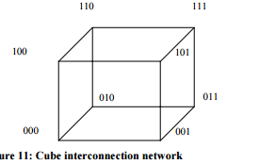
Cube:
It is a 3 dimensional interconnection network. In this the PE’s are arranged in a cube structure.

Slide 7
Hyper Cube:
A Hypercube interconnection network is an extension of cube network. Hypercube interconnection network for n ≥ 3, can be defined recursively as follows:
For n = 3, it cube network in which nodes are assigned number 0, 1, ……,7 in binary. In other words, one of the nodes is assigned a label 000, another one as 001…. and the last node as 111.
Then any node can communicate with any other node if their labels differ in exactly one place, e.g., the node with label 101 may communicate directly with 001, 100 and 111.

Slide 8
Hyper Cube:
For n > 3, a hypercube can be defined recursively as follows: Take two hypercubes of dimension (n – 1) each having (n –1) bits labels as 00….0, ……11…..1
Next join the two nodes having same labels each (n – 1) -dimension hypercubes and join these nodes. Next prefix ‘1’ the labels of one of the (n – 1) dimensional hypercube and ‘0’ to the labels of the other hypercube. This completes the structure of n-dimensional hypercube. Direct connection is only between that pair of nodes which has a (solid) line connecting the two nodes in the pair.

Slide 9
Construction of hypercubes from hypercubes of lower dimension.

Slide 10
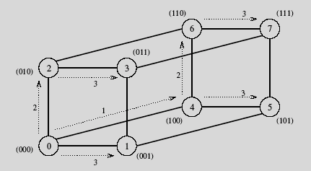
Broadcast on a Hypercube: Example
One-to-all broadcast on a three-dimensional hypercube.

Slide 11
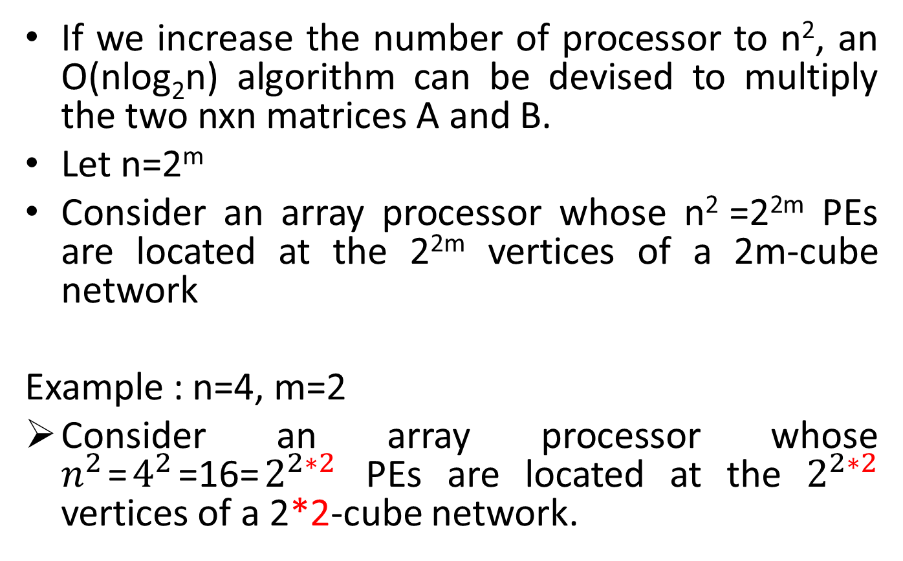
An O(n log₂n ) algorithm for matrix multiplication
If we increase the number of processor to n², an O(nlog₂n) algorithm can be devised to multiply the two nxn matrices A and B.
Let n=2^{m}
Consider an array processor whose n² =2^{2m} PEs are located at the 2^{2m} vertices of a 2m-cube network
Example : n=4, m=2
Consider an array processor whose $n^{2}$=$4^{2}$=16=$2^{2∗2}$ PEs are located at the $2^{2∗2}$ vertices of a 2*2-cube network.

Slide 12
An O(n log₂n ) algorithm for matrix multiplication
A 2m-cube network can be considered as two
(2m – 1) cube networks linked together by 2^{2m-1} extra edges.
So a 2*2-cube network can be considered as two (2*2-1=3) cube network linked together by 8=2^{2*2-1} extra edges between corresponding vertices at the corner positions.
(As shown in fig 2 only one of the eight fourth dimension is shown for clarity).

Slide 13
Example
1 | 1 | 1 | 1
2 | 2 | 2 | 2
3 | 3 | 3 | 3
4 | 4 | 4 | 4
1 | 2 | 3 | 4
1 | 2 | 3 | 4
1 | 2 | 3 | 4
1 | 2 | 3 | 4
A=
B=
1 | 1 | 1 | 1
2 | 2 | 2 | 2
3 | 3 | 3 | 3
4 | 4 | 4 | 4
B^{t}=

Slide 14
An O(n log₂n ) algorithm for matrix multiplication
Let (P_{2m-1} P_{2m-2}… P_{m} P_{m-1} P_{m-2}…. P₁P₀ )₂ be the PE address in the 2m cube.
Example: P₃P₂P₁P₀ (because 2m-1= 3)
We can achieve the O(n log₂n ) compute time only if initially the matrix elements are favorably distributed in the PE vertices.
Initialization :
The n rows of matrix A are distributed over n distinct PEs whose addresses satisfy the condition:
P_{2m-1} P_{2m-2}… P_{m}= P_{m-1} P_{m-2}…. P₀

Slide 15
An O(n log₂n ) algorithm for matrix multiplication
Example below:
P_{2*2-1}P_{2*2-2}=P₂₋₁P₂₋₂
P₃P₂=P₁P₀
0110
0111
1110
1111
4A
0010
0011
1010
1011
3A
0101
1101
0100
2A
1100
0000
0001
1000
1001
1A

Slide 16
An O(n log₂n ) algorithm for matrix multiplication
1. Transpose B to form B^{t} over the m-cubes x_{2m-1} … x_{m}0…0 in nlog₂n steps
Example:
x_{2*2-1}x_{2*2-2}00
x₃x₂00

Slide 17
Algorithm for matrix multiplication on a 2m-cube network:
0110
1110
0111
1111
0010
1011
0011
1010
4B^{t}
1101
0100
0101
1100
2B^{t}
0000
1000
0001
1001
1B^{t}
3B^{t}

Slide 18
Algorithm for matrix multiplication on a 2m-cube network:
2. N-way broadcast each row of B^{t} to all PEs in the m cube P_{2m-1} ..P_{m} x_{m-1} … x₀ in nlog₂n steps
Example:
P_{2*2-1} P_{2*2-2} x₂₋₁x₂₋₂
P₃ P₂ x₁x₀

Slide 19
Algorithm for matrix multiplication on a 2m-cube network:
2B^{t}
2B^{t}
4B^{t}
0110
1110
4A
0111
4B^{t}
1111
1B^{t}
1B^{t}
3B^{t}
3B^{t}
0010
1010
1011
0011
3A
2B^{t}
4B^{t}
4B^{t}
2A
1101
0100
0101
2B^{t}
1100
0000
1000
1001
1B^{t}
1B^{t}
0001
3B^{t}
1A
3B^{t}

Slide 20
Algorithm for matrix multiplication on a 2m-cube network:
3. N-way broadcast each row of A residing in PE P_{2m-1} ..P_{m} P_{m-1} … P₀ to all PEs in the m-cube
x_{2m-1} … x_{m} P_{m-1} … P₀ in nlog₂n steps.
All the n rows can be broadcast in parallel
Example :
x_{2*2-1} x_{2*2-2} P_{m-1} … P₀
x₃ x₂ P₁P₀

Slide 21
Algorithm for matrix multiplication on a 2m-cube network:
4A
1110
4A
3A
0110
0111
3A
1111
3A
4A
3A
4A
0010
0011
1010
1011
1A
1A
2A
1101
0100
0101
1100
2A
0000
1A
1000
1001
0001
2A
1A
2A

Slide 22
Algorithm for matrix multiplication on a 2m-cube network:
4.
Each PE now contains a row of A and a column of B and can form the inner product in O(n) steps.
The n elements of each result row can be brought together within the same PEs which initially held a row of A in O(n) steps.

Slide 23
Algorithm for matrix multiplication on a 2m-cube network:
0110
4A.4B^{t}
3A.2B^{t}
0111
1110
4A.2B^{t}
3A.4B^{t}
1111
3A.1B^{t}
4A.1B^{t}
3A.3B^{t}
4A.3B^{t}
0010
1010
1011
0011
1A.2B^{t}
2A.2B^{t}
1A.4B^{t}
0101
1101
0100
2A.4B^{t}
1100
0000
1A.1B^{t}
0001
1000
1001
2A.1B^{t}
1A.3B^{t}
2A.3B^{t}

